Slide 1
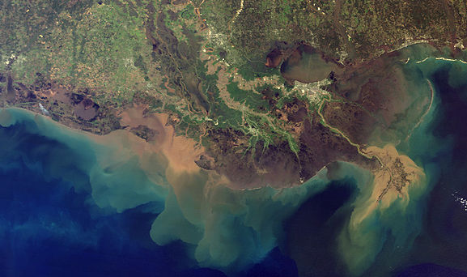
Expert Panel on Diversion Planning and Implementation: Meeting #3
October 28, 2014

Slide 2
Expert Panel on Diversion Planning and Implementation: Background
Formed to provide technical advice on planning and implementation of freshwater and sediment diversion projects
Expertise encompasses the natural and social sciences as well as engineering
Experience with Mississippi River and Louisiana restoration (or other large restoration projects)
Expected to meet up to three times per year over next three years

Slide 3
Frequently Asked Questions
Why are there no Panel members from Louisiana?
  Experts from Louisiana are in fact currently engaged and leading much of the work
  The Panel was established to review and advise the CPRA and the teams that are engaged in these efforts
What authority does the Panel have?
  We are not a decision-making panel
  We will provide expert advice and recommendations for consideration
Is the Panel reviewing the decisions made in the Master Plan?
  No, the Panel is advising on science and research needs related to advancing and further developing/designing sediment diversion projects that were in the 2012 Comprehensive Master Plan

Slide 4
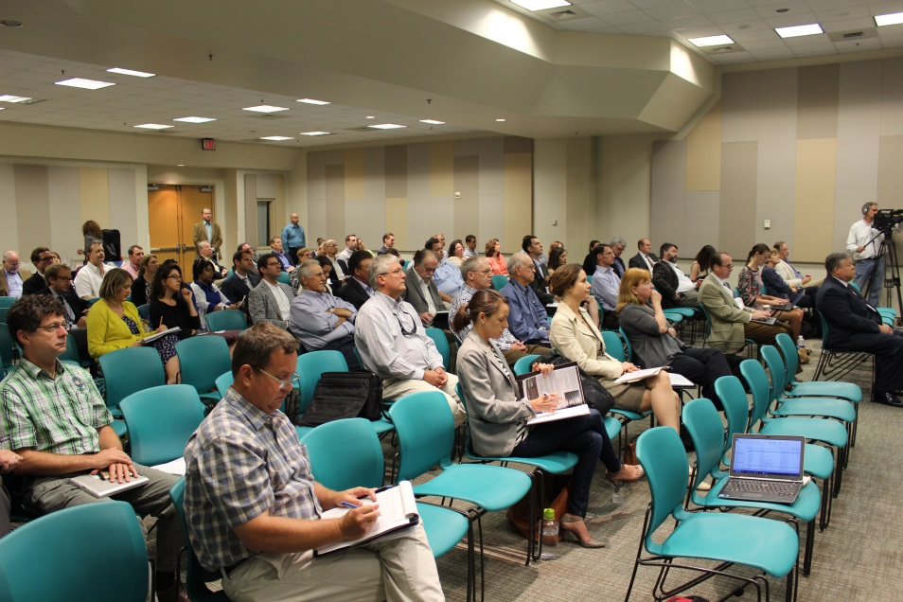
Summary of Meeting #2
Panel meeting was held April 29-May 1, 2014 in New Orleans (Day 1 field trip; public session at UNO)
Background presentations from CPRA, USACE, and The Water Institute of the Gulf
Focus on Mississippi River Hydrodynamic and Delta Management Study and on status of Mid-Barataria Sediment Diversion
Special panel discussion
on project-specific analyses
for large-scale diversions
Public comment period

Slide 5
Meeting #2 Report
Built on the 18 recommendations from Report #1
Focused on four broad areas
  1) Conceptual model of diversion outcomes and management endpoints
  2) Hydrodynamic modeling and data collection to optimize diversion operations
  3) Modeling ecological effects of diversions to further assess risk and uncertainty
  4) Short- and long-term needs and considerations in social science analysis
A total of seven recommendations with three timeframes for implementation: Fall 2014 Panel Meeting; 12-18 months; and, 2-3 years

Slide 6
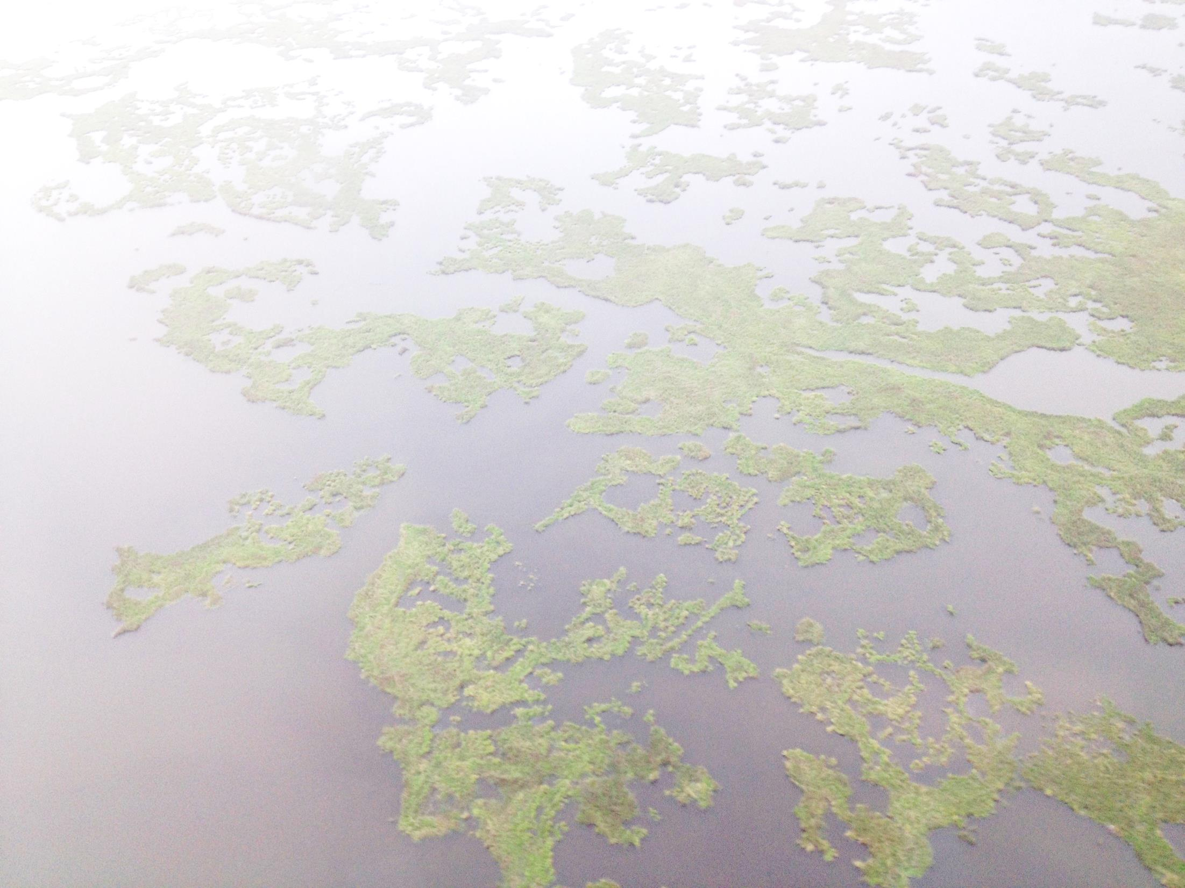
Broad Takeaway Messages
2012 Master Plan is cornerstone for restoration project planning but does not provide details on implementation and approach for planning diversions.
Data collection and modeling in Mississippi River comprehensive, and excellent analysis in West Bay; next step should be to evaluate impacts of diversion openings under various operation strategies.
Successful application of ecosystem models requires assessing risks, using multiple models, linking to physical and social models, conducting monitoring, making appropriate model selections, and conducting marsh experiments.
Social science research and analysis is inadequate, and accordingly there is a need to quickly make progress on identifying roles for social science and analysis in planning for diversions.

Slide 7
Recommendations | Timeframe for Implementation
Articulate an expanded view of the technical approach in planning for diversions. | Fall 2014 Panel Meeting
2. Focus data collection and hydrodynamic modeling on optimizing diversion operation. | 12-18 months (or less)
3. Provide presentations of ongoing ecosystems modeling efforts. | Fall 2014 Panel Meeting
4. Develop a review process to examine adequacy of monitoring data. | 12-18 months (or less)
5. Conduct whole-marsh experiment to understand impacts of combined effects of erosion, nutrients, and salinity. | 12-18 months (or more)
6. Develop a process to identify conflicts, tradeoffs, benefits and risks associated with diversions. | 12-18 months (or less)
7. Link longer-term social science research to key diversion questions. | 2-3 years

Slide 8

Report #2
Report of Meeting #2 available at: www.thewaterinstitute.org
Contents Include:
  Executive Summary
  Introduction and Background
  Focus of Meeting #2
  Discussion, Findings, and Recommendations
  Appendices 1-2
EXPERT PANEL ON DIVERSION
PLANNING AND IMPLEMENTATION
Report #2
June 2014
Submitted to:
Coastal Protection and Restoration Authority

Slide 9
Webinar – September 19
Focus on conceptual model with description of technical elements and decision points (overarching recommendation in Report #2)
Presentations by CPRA on technical planning approach with 1) Winter 2014 Decision Point on advancing alternatives, and 2) Summer 2015 Decision Point on advancing to full engineering and design
Review of Agenda for October meeting

Slide 10
Charge for Fall 2014 Panel Meeting
Provide specific recommendations on information that needs to be developed prior to upcoming decision points
Identify key limitations of data that can be remedied in time to inform 2015 "Decision to Implement"
Determine whether modeling approaches for fish and shellfish are appropriate for supporting 2014 and 2015 decisions

